Slide 1
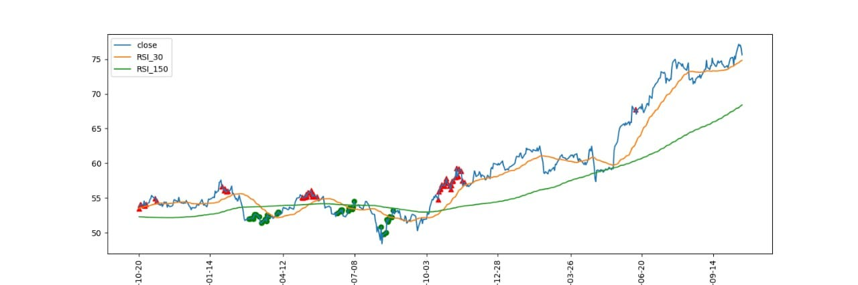
Stock price prediction
Stock Price Prediction is the task of forecasting future stock prices based on historical data and various market indicators. It involves using statistical models and machine learning algorithms to analyze financial data and make predictions about the future performance of a stock. The goal of stock price prediction is to help investors make informed investment decisions by providing a forecast of future stock prices.

Slide 2
Stock price prediction is the process of using historical data and various techniques to forecast the future price movements of stocks or financial assets. It plays a crucial role in financial markets and investment strategies. Here's a summary of stock price prediction:
Data Collection: Stock price prediction starts with the collection of historical data, including stock prices, trading volumes, financial statements, economic indicators, and news sentiment data. The more data available, the better the predictions can be.
Data Preprocessing: Data preprocessing involves cleaning and organizing the collected data. This step may include handling missing values, removing outliers, and normalizing the data to make it suitable for modeling.
Feature Engineering: Feature engineering is the process of selecting and creating relevant features (variables) from the data that can impact stock prices. Common features include moving averages, technical indicators (e.g., RSI, MACD), and financial ratios.
Model Selection: Stock price prediction models can range from traditional statistical models (e.g., ARIMA, GARCH) to more advanced machine learning algorithms (e.g., regression, decision trees, neural networks). The choice of model depends on the data and the problem at hand.
Training and Testing: The historical data is divided into training and testing sets. The model is trained on the training data to learn patterns and relationships. The testing data is used to evaluate the model's performance.
s

Slide 3
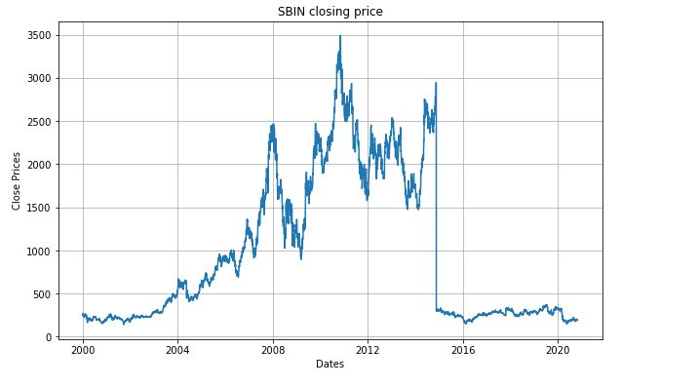
Forecasting using stacked LSTM
P/E, P/B, PEG, and dividend yields are four commonly used metrics that can help break down a stock's value and outlook. Any single ratio is too narrowly focused to stand alone, so combining these and other financial ratios gives a more complete picture.

Slide 4
Code for stock price prediction
import numpy as np
import pandas as pd
import matplotlib.pyplot as plt
import seaborn as sb
from sklearn.model_selection import train_test_split
from sklearn.preprocessing import StandardScaler
from sklearn.linear_model import LogisticRegression
from sklearn.svm import SVC
from xgboost import XGBClassifier
from sklearn import metrics
import warnings
warnings.filterwarnings('ignore')

Slide 5
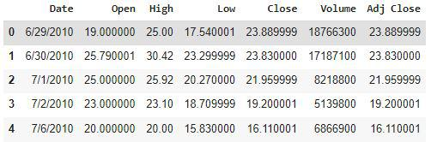
Importing Dataset
df = pd.read_csv('/content/Tesla.csv') df.head()

Slide 6
Evaluation Metrics: Common evaluation metrics for stock price prediction models include Mean Absolute Error (MAE), Mean Squared Error (MSE), Root Mean Squared Error (RMSE), and accuracy. These metrics help assess how well the model's predictions match the actual stock prices. Hyperparameter Tuning: Fine-tuning model hyperparameters can improve prediction accuracy. This involves adjusting parameters such as learning rates, batch sizes, and the number of hidden layers in neural networks. Backtesting and Validation: Backtesting involves applying the model to historical data to simulate trading strategies and evaluate their performance. Validation ensures that the model's predictions are reliable and not overfitting the training data. Deployment: Once a satisfactory model is developed and validated, it can be deployed for real-time stock price prediction. Traders and investors can use these predictions to make informed decisions.
s

